Slide 1
CAPSTONE PROJECT
ALY 6140: Analytics Systems Technology
Group 3
Trieu Vo
Nilay Anand
Yash Tadiyal
Ashutosh Singh
Rohit Meena

Slide 2
TABLE OF CONTENTS
Project Roles & Responsibilities
Project Introduction
Data Extraction & Cleanup
Data Visualization
Predictive Models Building
Interpretation & Conclusions
Code Files & Final Report

Slide 3
1. Project roles & responsibilities
Roles | Members
Project Manager | Nilay Anand
Business intelligence | Ashutosh Singh
Programmer | Trieu Vo
Statistical modeler | Yash Tadiyal
Data Engineer | Rohit Meena

Slide 4
1. Project roles & responsibilities
Members | Responsibilities
Rohit / Ashu | - Define Goals, Questions, Methods, Dimension of Data and Rationale of Data.
Trieu / Rohit | Data Extraction & Cleanup: Import the dataset, add the zip code, evaluate features for selection Select features and fill missing values
Trieu / Nilay / Yash / Ashu | Visualizations: - Visualize the data and analyze the information in the data
Yash / Rohit | Building models: - Use different Models to examine the data and predict the price of listings
Trieu / Nilay / Ashutosh / Yash / Rohit | Interpretation & Conclusions: - Answer questions

Slide 5
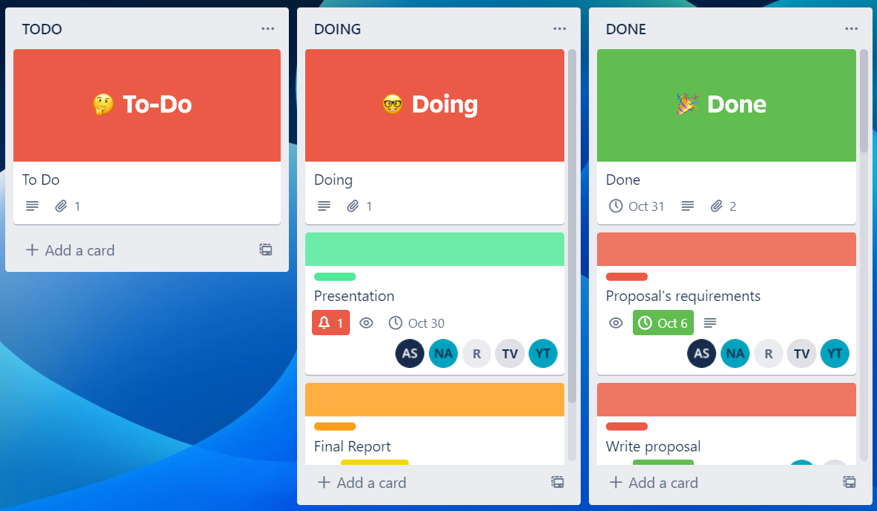
1. Project roles & responsibilities
Trello
Follow up on the work progress of team members
https://trello.com/b/N2xHwVsC/kanban

Slide 6
2. Project Introduction
Introduction | Content
Goals | To learn how to analyze the dataset of Airbnb with all necessary steps in Data Science and finally answer questions.
Questions | Which is the most profitable property? Which is the most profitable zip code? How to increase the chances that the owners' house will be rented more frequently?
Methods | Data Rationale, Data Extraction & Cleanup. Data Visualization. Predictive Models Building.

Slide 7
2. Project Introduction
Introduction | Content | Rationale
Data source | Inside Airbnb | To evaluate listings and answer questions
Cities | All 28 cities in the US 207,006 samples | To make sure that we don’t skip cities that have the most profitable zip code
Features | 16 features | After evaluating 74 features in the dataset, we removed redundant features and kept 16 features to analyze useful information

Slide 8
3. Data Extraction & Cleanup
Load data from listings links of the dataset
Append listings into 1 data frame
Add zip code to the listings
Evaluate missing values to select features
Select useful features & Remove unnecessary columns

Slide 9
3. Data Extraction - Add zip code to the listings
Try to use geopy library to get the zip code of 200,000 locations
➤➤ Time – consuming (48 hours running)

Slide 10
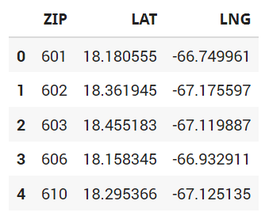
3. Data Extraction - Add zip code to the listings
CSV file with zip code, latitude, longitude:
https://gist.githubusercontent.com/erichurst/7882666/raw/5bdc46db47d9515269ab12ed6fb2850377fd869e/US%2520Zip%2520Codes%2520from%25202013%2520Government%2520Data

Slide 11
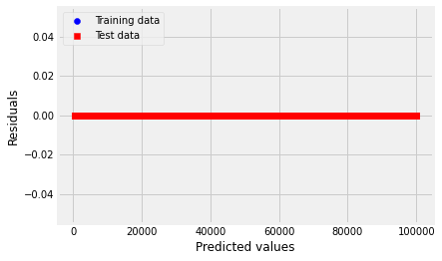
3. Data Extraction - Add zip code to the listings
Create and train the K Nearest Neighbors model to predict the zip code
Results:
K-Nearest Neighbors MSE train: 0.000, test: 0.000
K-Nearest Neighbors R^2 train: 1.000, test: 1.000

Slide 12
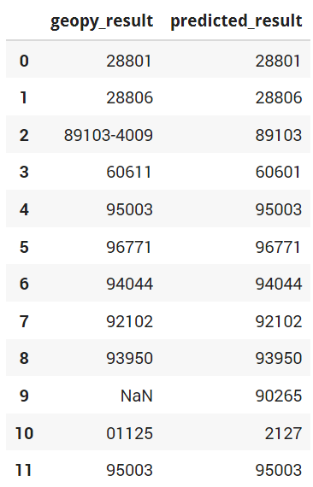
3. Data Extraction - Add zip code to the listings
Check on several latitude, longitude using geopy and knn model
Geopy gives non-value zip code or wrong zip code, while knn model predicts correctly (after checking on find zip code websites)

Slide 13
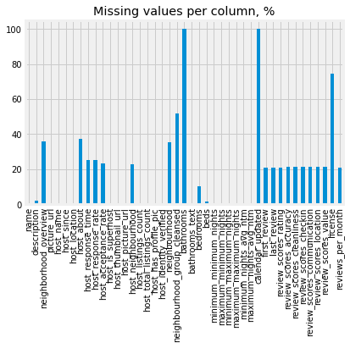
3. Data Extraction - Evaluate missing values to select features
Evaluate 74 features
Avoid choosing bathrooms, calendar_updated, license and other features that have a lot of missing values

Slide 14
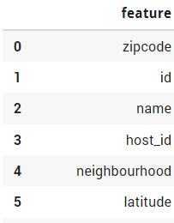
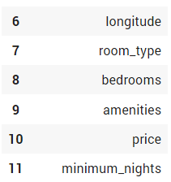
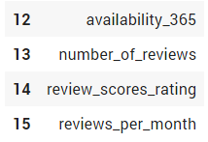
3. Data Extraction - Select features & Remove unnecessary columns

Slide 15
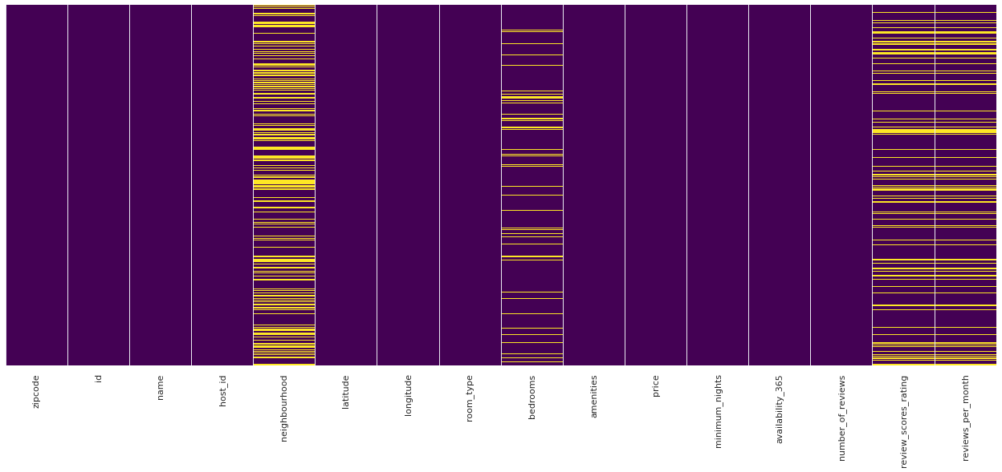
3. Data Cleanup

Slide 16
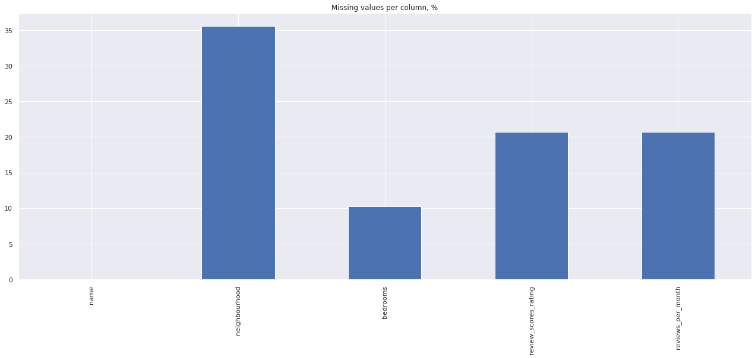
3. Data Cleanup

Slide 17
3. Data Cleanup
Fill missing values for 4 features:
Neighbourhood (ffill: previous value)
Bedrooms (mean value)
Reviews_score_rating(ffill: previous value)
Reviews_per_month (mean value)

Slide 18
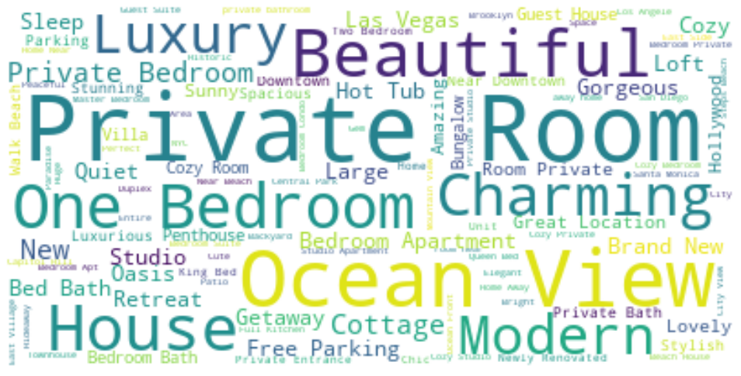
4. Data Visualization – Name of listing
We can see that some words that are most concerned are:
1. Private Room
2. Ocean View
3. Beautiful
4. One Bedroom
5. Modern
6. Charming
7. Luxury

Slide 19
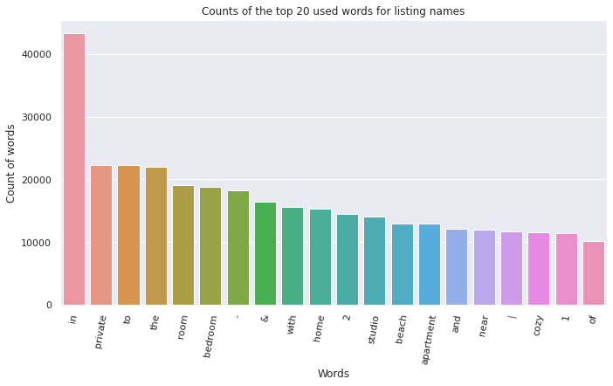
4. Data Visualization - Name of listing
We can see that people care about locations that are "private, have bedroom, studio, beach, apartment, and cozy locations"

Slide 20
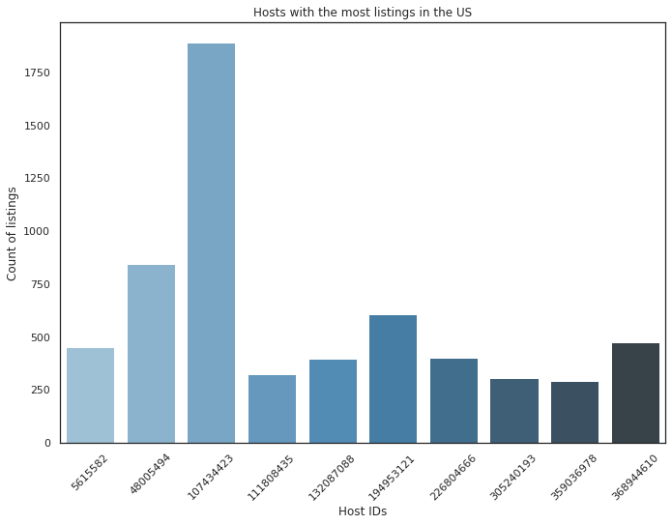
4. Data Visualization – Host ID
The host with the host_id "107434423" has the largest number of listings on Airbnb (1891 listings)

Slide 21
4. Data Visualization – Neighbourhood & Zip code
1313 neighbourhoods & 1637 zip codes in the dataset

Slide 22
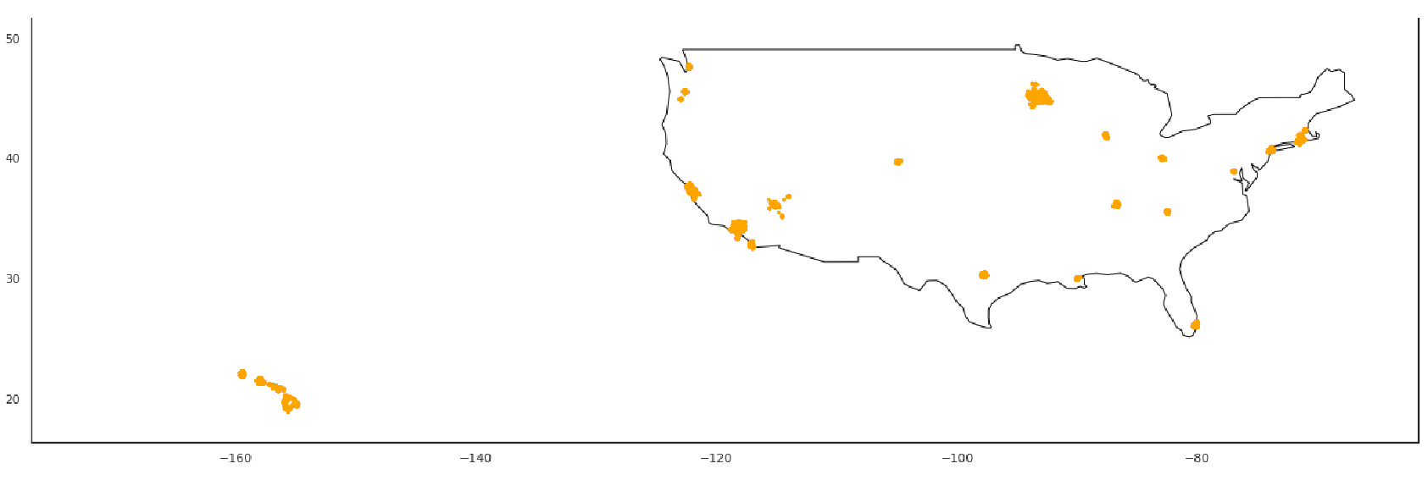
4. Data Visualization – Latitude & Longitude
Places which have a lot of listings are California, Chicago, Hawaii and New York
Most profitable properties & zip codes may be in these areas

Slide 23
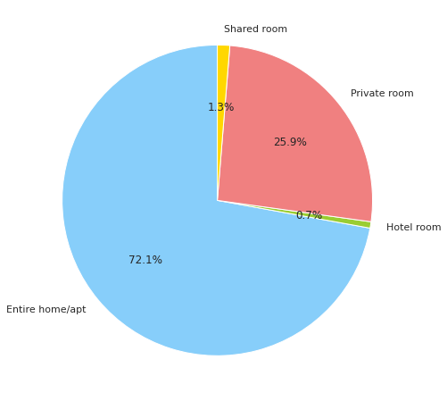
4. Data Visualization – Room type
Entire home / apartment is most prefered and Hotel room is least preferred
People care about renting the entire home / apartment and they don't like Hotel room

Slide 24
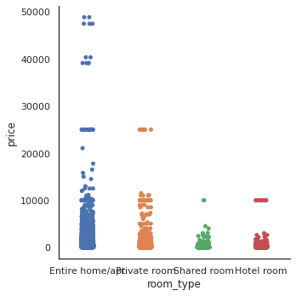
4. Data Visualization – Room type
The majority of room types are below $10,000.
1. Most "entire home / apartment" and "Private room" have the daily price under $10,000.
2. Most "Shared room" and "Hotel room" have the daily price under $5,000.

Slide 25
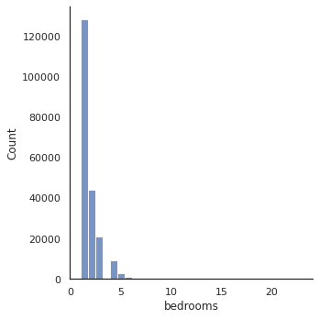
4. Data Visualization - Bedroom
Locations with single bed is the most preferred

Slide 26
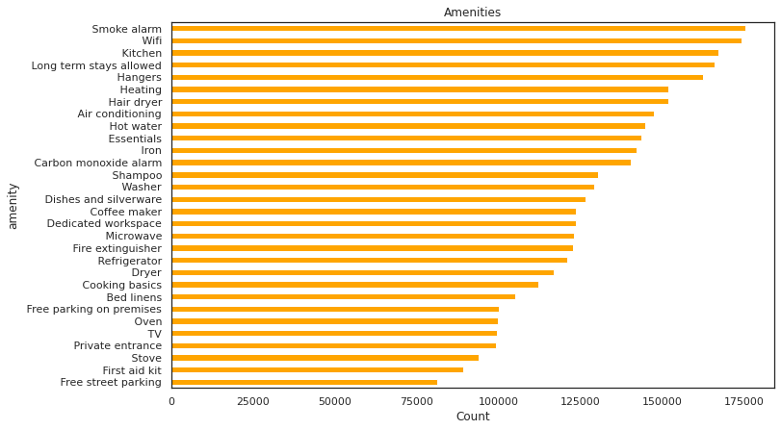
4. Data Visualization - Amenities

Slide 27
4. Data Visualization - Amenities
People care about locations that have smoke alarm (to save their lives), wifi (to surf the internet), kitchen (to cook meals), long-term stays (in vacations), hangers, heating, hair dryer, air conditioning and hot water.

Slide 28
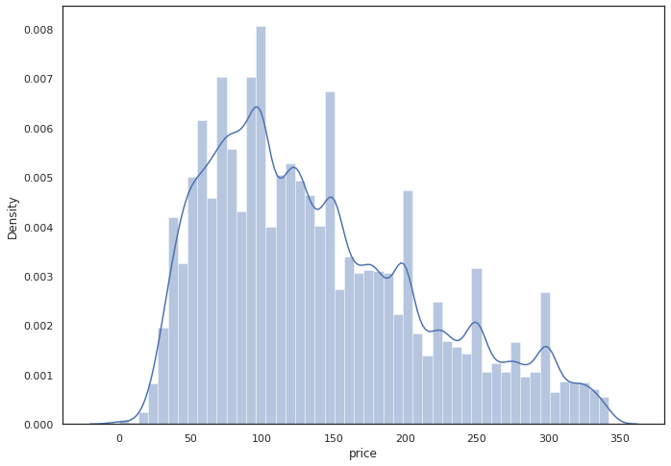
4. Data Visualization - Daily Price
Minimum price per listing is 0.0$.
Maximum price per listing is 342.0$
Average price per listing is 139.02$ (after remove outliers)

Slide 29
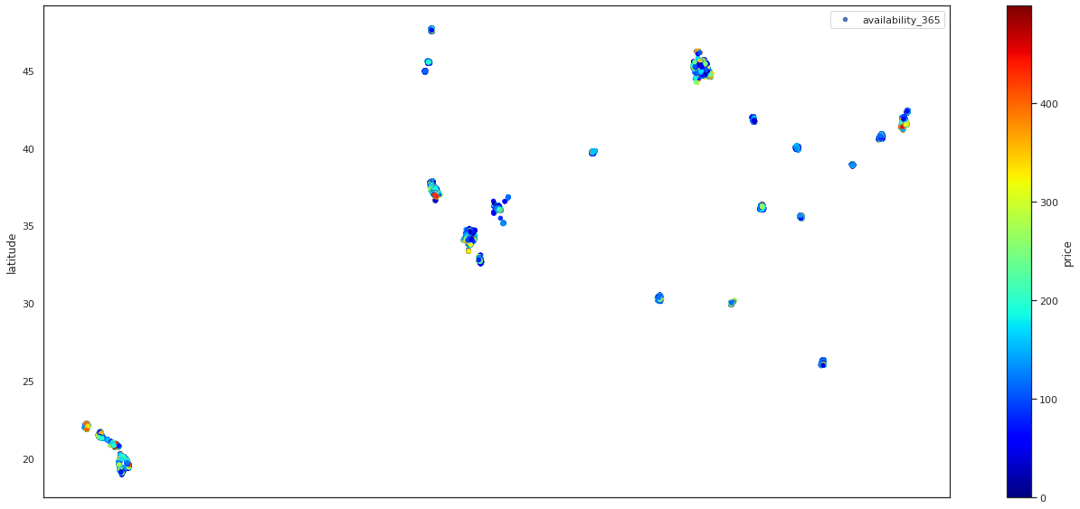
4. Data Visualization - Daily Price

Slide 30
4. Data Visualization - Daily Price
Places that are crowded will offer many listings with the highest prices (California, Chicago, Hawaii and New York).
We can concentrate on these locations to find out the most profitable zip code.

Slide 31
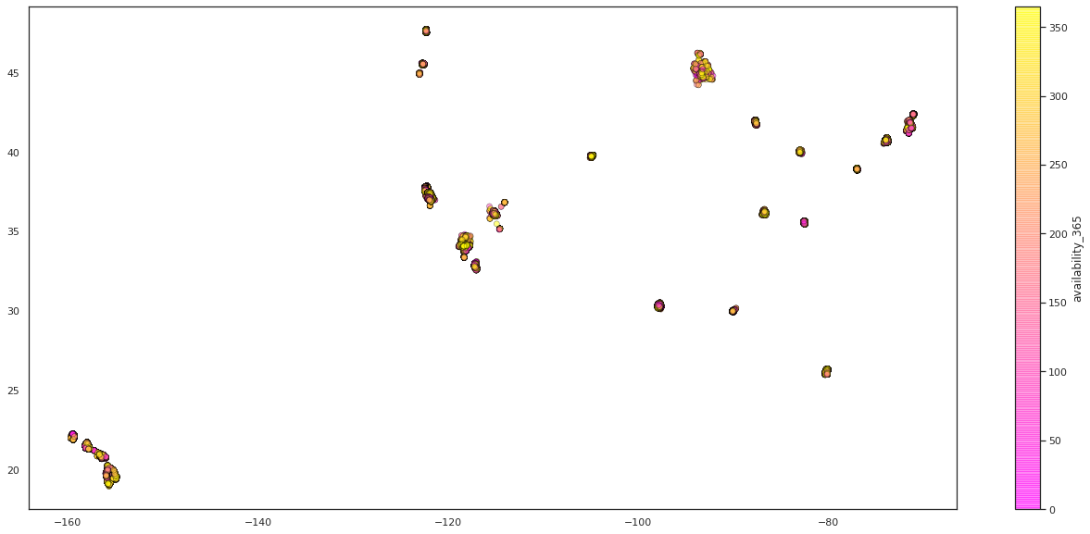
4. Data Visualization – Room availability
Most listings are available over 200 days (6 months) in year.

Slide 32
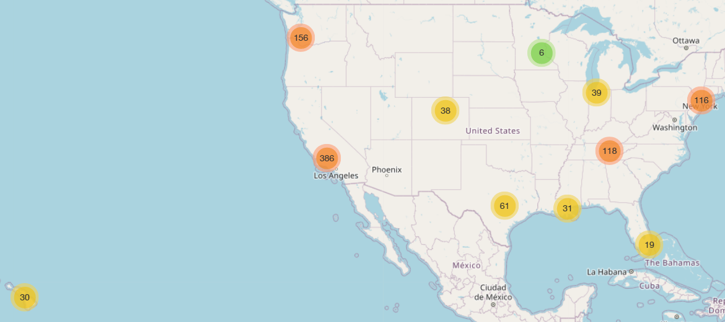
4. Data Visualization – Number of reviews
Visualize 1000 locations which have the highest number of reviews

Slide 33
4. Data Visualization – Number of reviews
Number of reviews = number of visits
➤ States that are most visited are California, Washington, New York and Tennessee.
➤ We can concentrate on these locations to find out the most profitable zip code.

Slide 34
5. Predictive Models -
price of listings
Build Linear Regression, Decision Tree and K-Nearest Neighbors models to predict the price of listings.
Using Random Forest and XGBoost to evaluate the factors affecting the rent of a property.

Slide 35
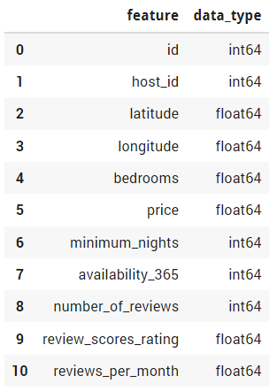
5. Predictive Models
List of numeric attributes used to train the predictive models

Slide 36
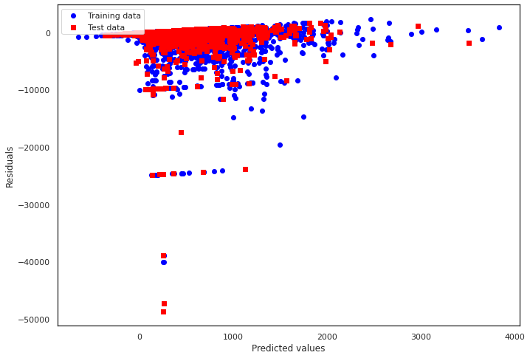
5. Predictive Models
Mean squared error (MSE) is the average of sum of squared difference between actual value and the predicted or estimated value.
R-Squared is the ratio of Sum of Squares Regression and Sum of Squares Total.
Linear Regression:
MSE train: 349827.902, test: 418670.400
R^2 train: 0.092, test: 0.075

Slide 37
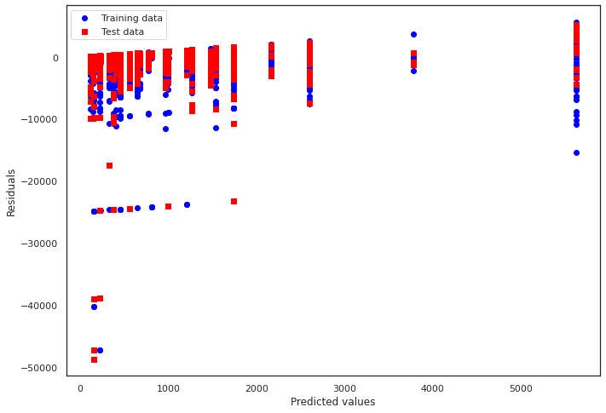
5. Predictive Models
Decision Tree:
MSE train: 328616.156, test: 403920.103
R^2 train: 0.147, test: 0.108

Slide 38
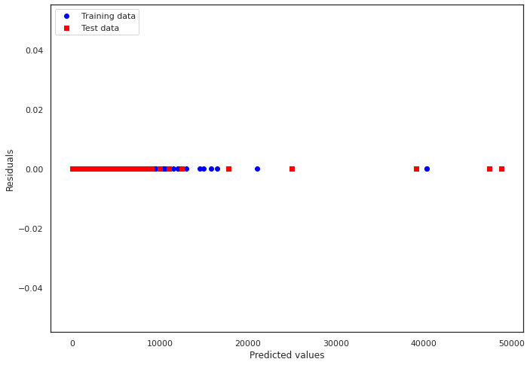
5. Predictive Models
K-Nearest Neighbourhood:
MSE train: 0.000, test: 0.000
R^2 train: 1.000, test: 1.000

Slide 39
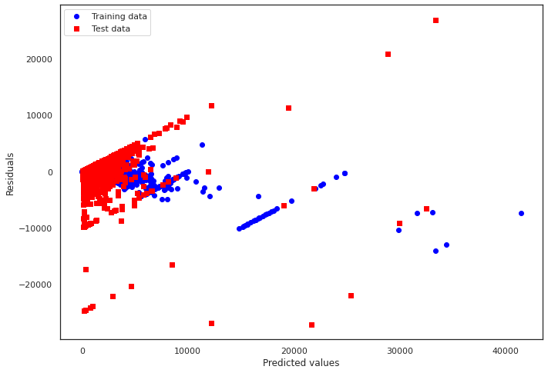
5. Predictive Models
Random Forest:
MSE train: 32832.664, test: 244568.729
R^2 train: 0.915, test: 0.429

Slide 40
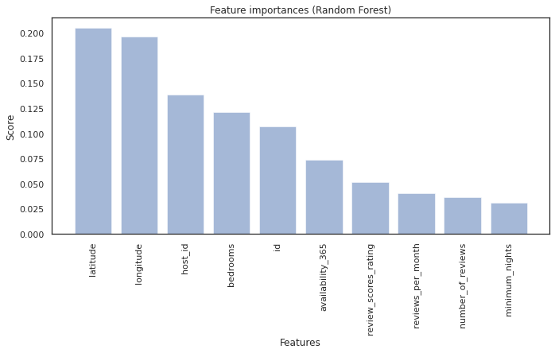
5. Predictive Models
Random Forest:
Random forest is based on the idea that a large number of substantially uncorrelated models (trees) working together as a group will outperform any of the individual component models.
We can see that factors have the most influence on price: longitude, latitude, host_id and bedrooms.

Slide 41
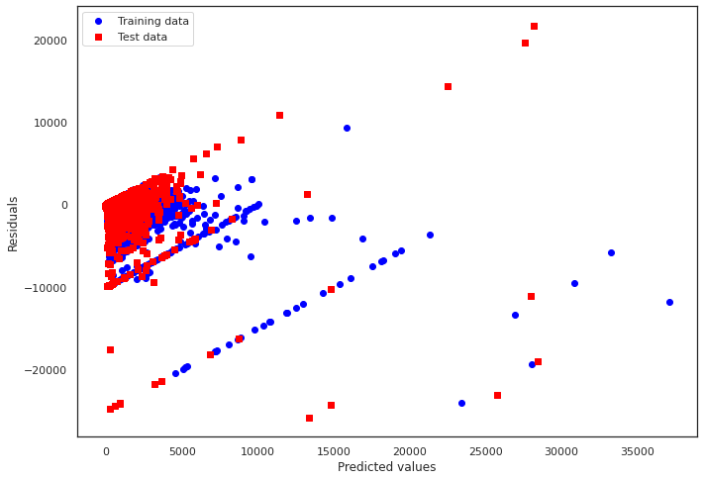
5. Predictive Models
XGBoost:
MSE train: 124562.931, test: 242405.204
R^2 train: 0.677, test: 0.434

Slide 42
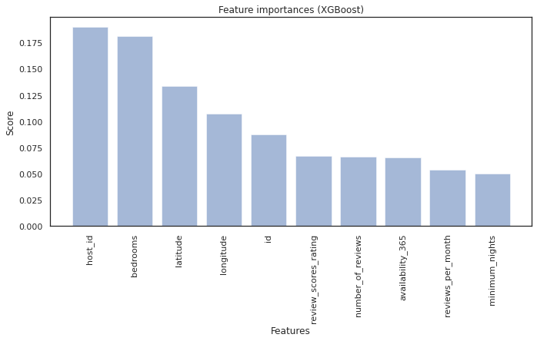
5. Predictive Models
XGBoost:
The XGBoost technique produces decision trees sequentially to solve regression problems (rather than in parallel and independently, as Random Forest does), with each succeeding tree aiming to minimize the preceding tree's faults.
We can see that factors have the most influence on price: host_id, longitude, latitude and bedrooms.

Slide 43
5. Predictive Models
Features that have most influence on price are: longitude, latitude, bedrooms, host_id
The price might depend on reviews: customer ratings and number of reviews.

Slide 44
FIND THE MOST PROFITABLE PROPERTIES
Profit score of 1 listing = daily price of 1 person * number of reviews (number of visits)

Slide 45
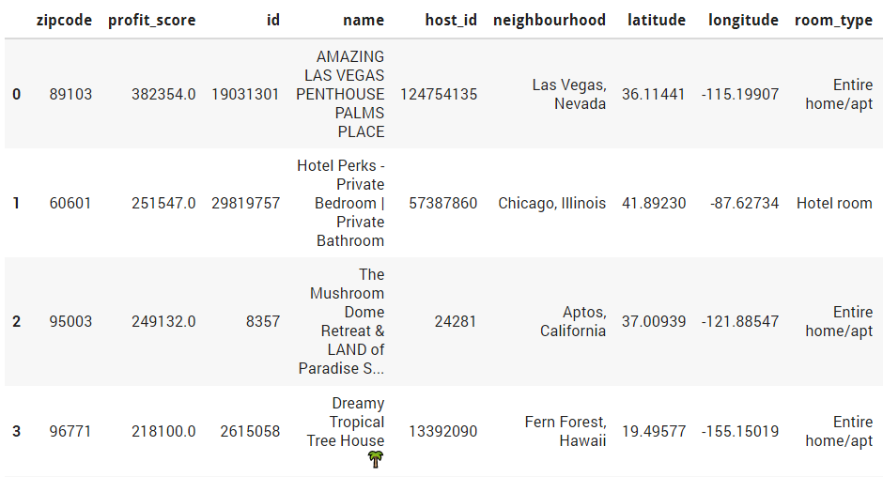
FIND THE MOST PROFITABLE PROPERTIES

Slide 46
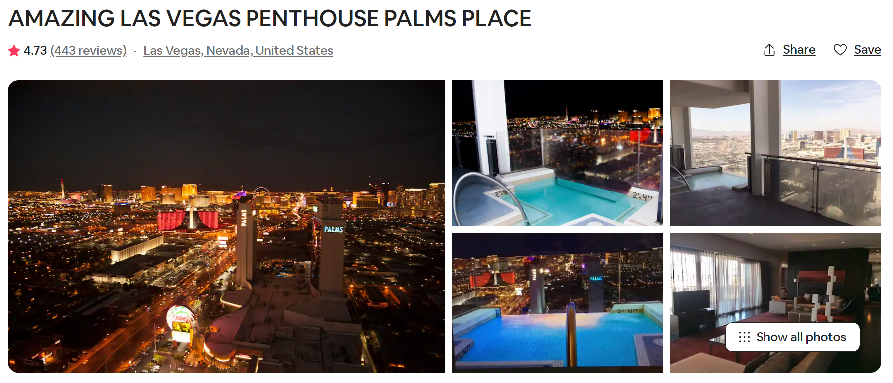
FIND THE MOST PROFITABLE PROPERTIES

Slide 47
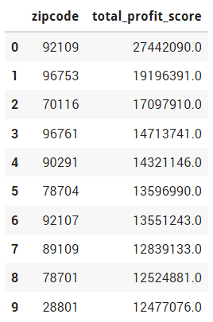
FIND THE MOST PROFITABLE ZIP CODE
Group by zip code
Calculate the total profit score of each zip code
➤➤ The most profitable zip code is: 92109
The zip code is in San Diego, California

Slide 48
6. Interpretation & Conclusions
Which is the most profitable property?
AMAZING LAS VEGAS PENTHOUSE PALMS PLACE. The zipcode of this place is 89103.
Which is the most profitable zipcode?
The most profitable zip code is: 92109. The zipcode is in San Diego, California.
How to increase the chances that the owners' house will be rented more frequently?
The hosts should offer entire home / apartment room type. They also need to equip these things in their listings: Kitchen, Long term stays allowed, Hangers, Heating, Hair dryer, Air conditioning, Hot water… Besides, they should add these words in the name of their listing: private room, ocean view, beautiful, one bedroom, modern, charming, luxury. Because these are the words that the renters usually look for.
This will assist the hosts in obtaining more renters and increasing their revenue.
Finally, Features that have most influence on price are: longitude, latitude, bedrooms, host_id

Slide 49
THANK YOU!
Any questions?

